Slide 1
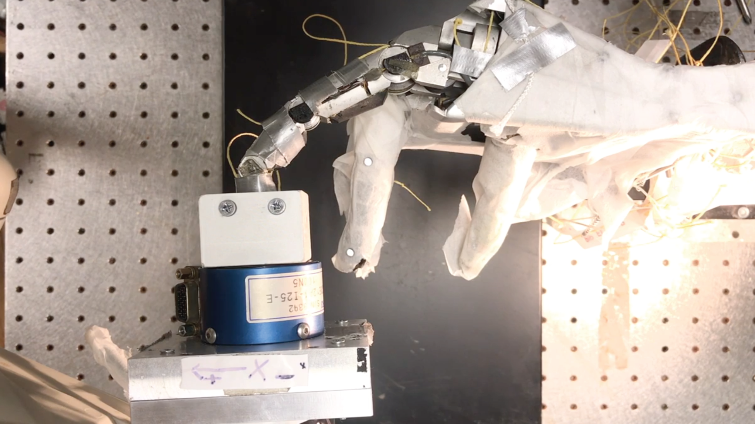

Analytics for tendon-driven robotic limb endpoint force production
^{1.} Brian Cohn
² Kian Jalaleddini
^{2,3}Francisco Valero-Cuevas
¹Computer Science
²Biokinesiology and Physical Therapy
³Biomedical Engineering
Brian.cohn@usc.edu

Slide 2
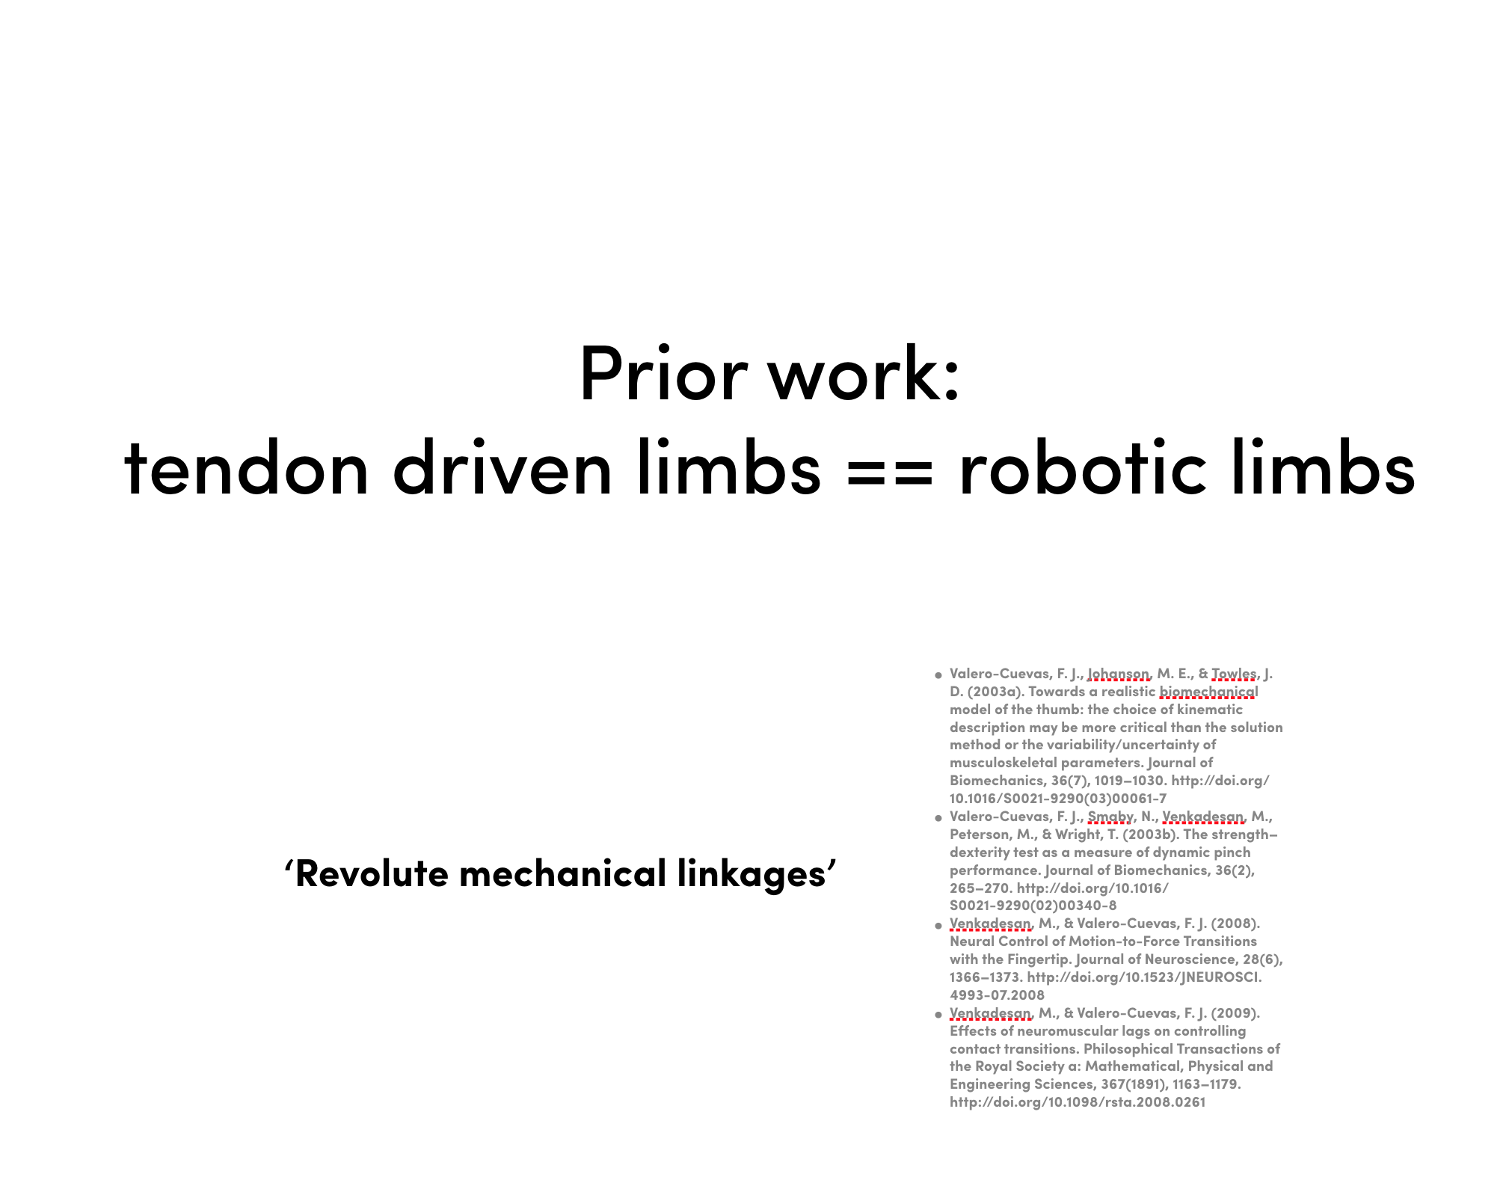
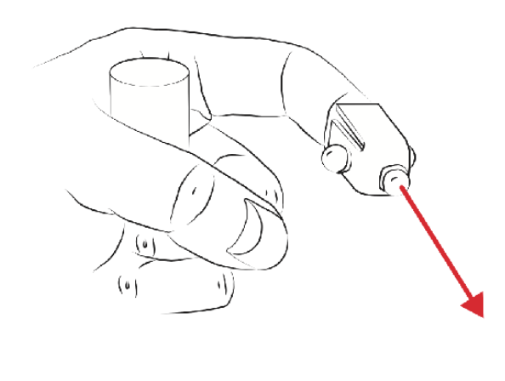
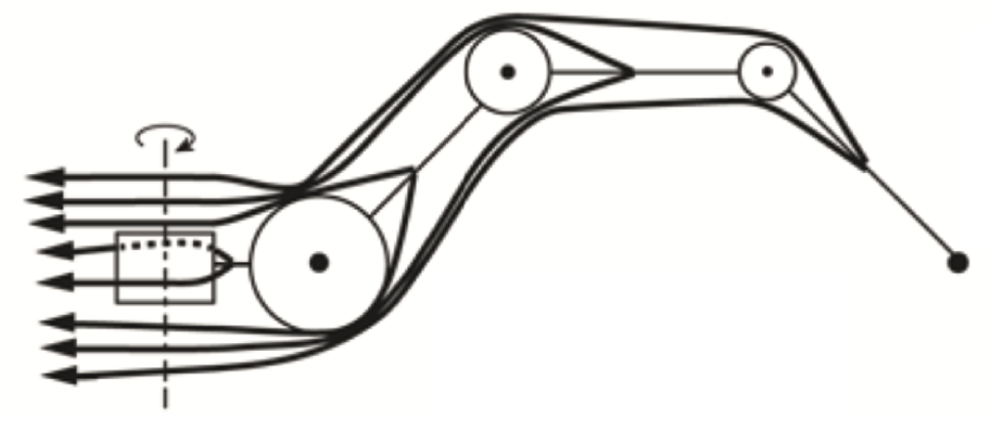

Slide 3
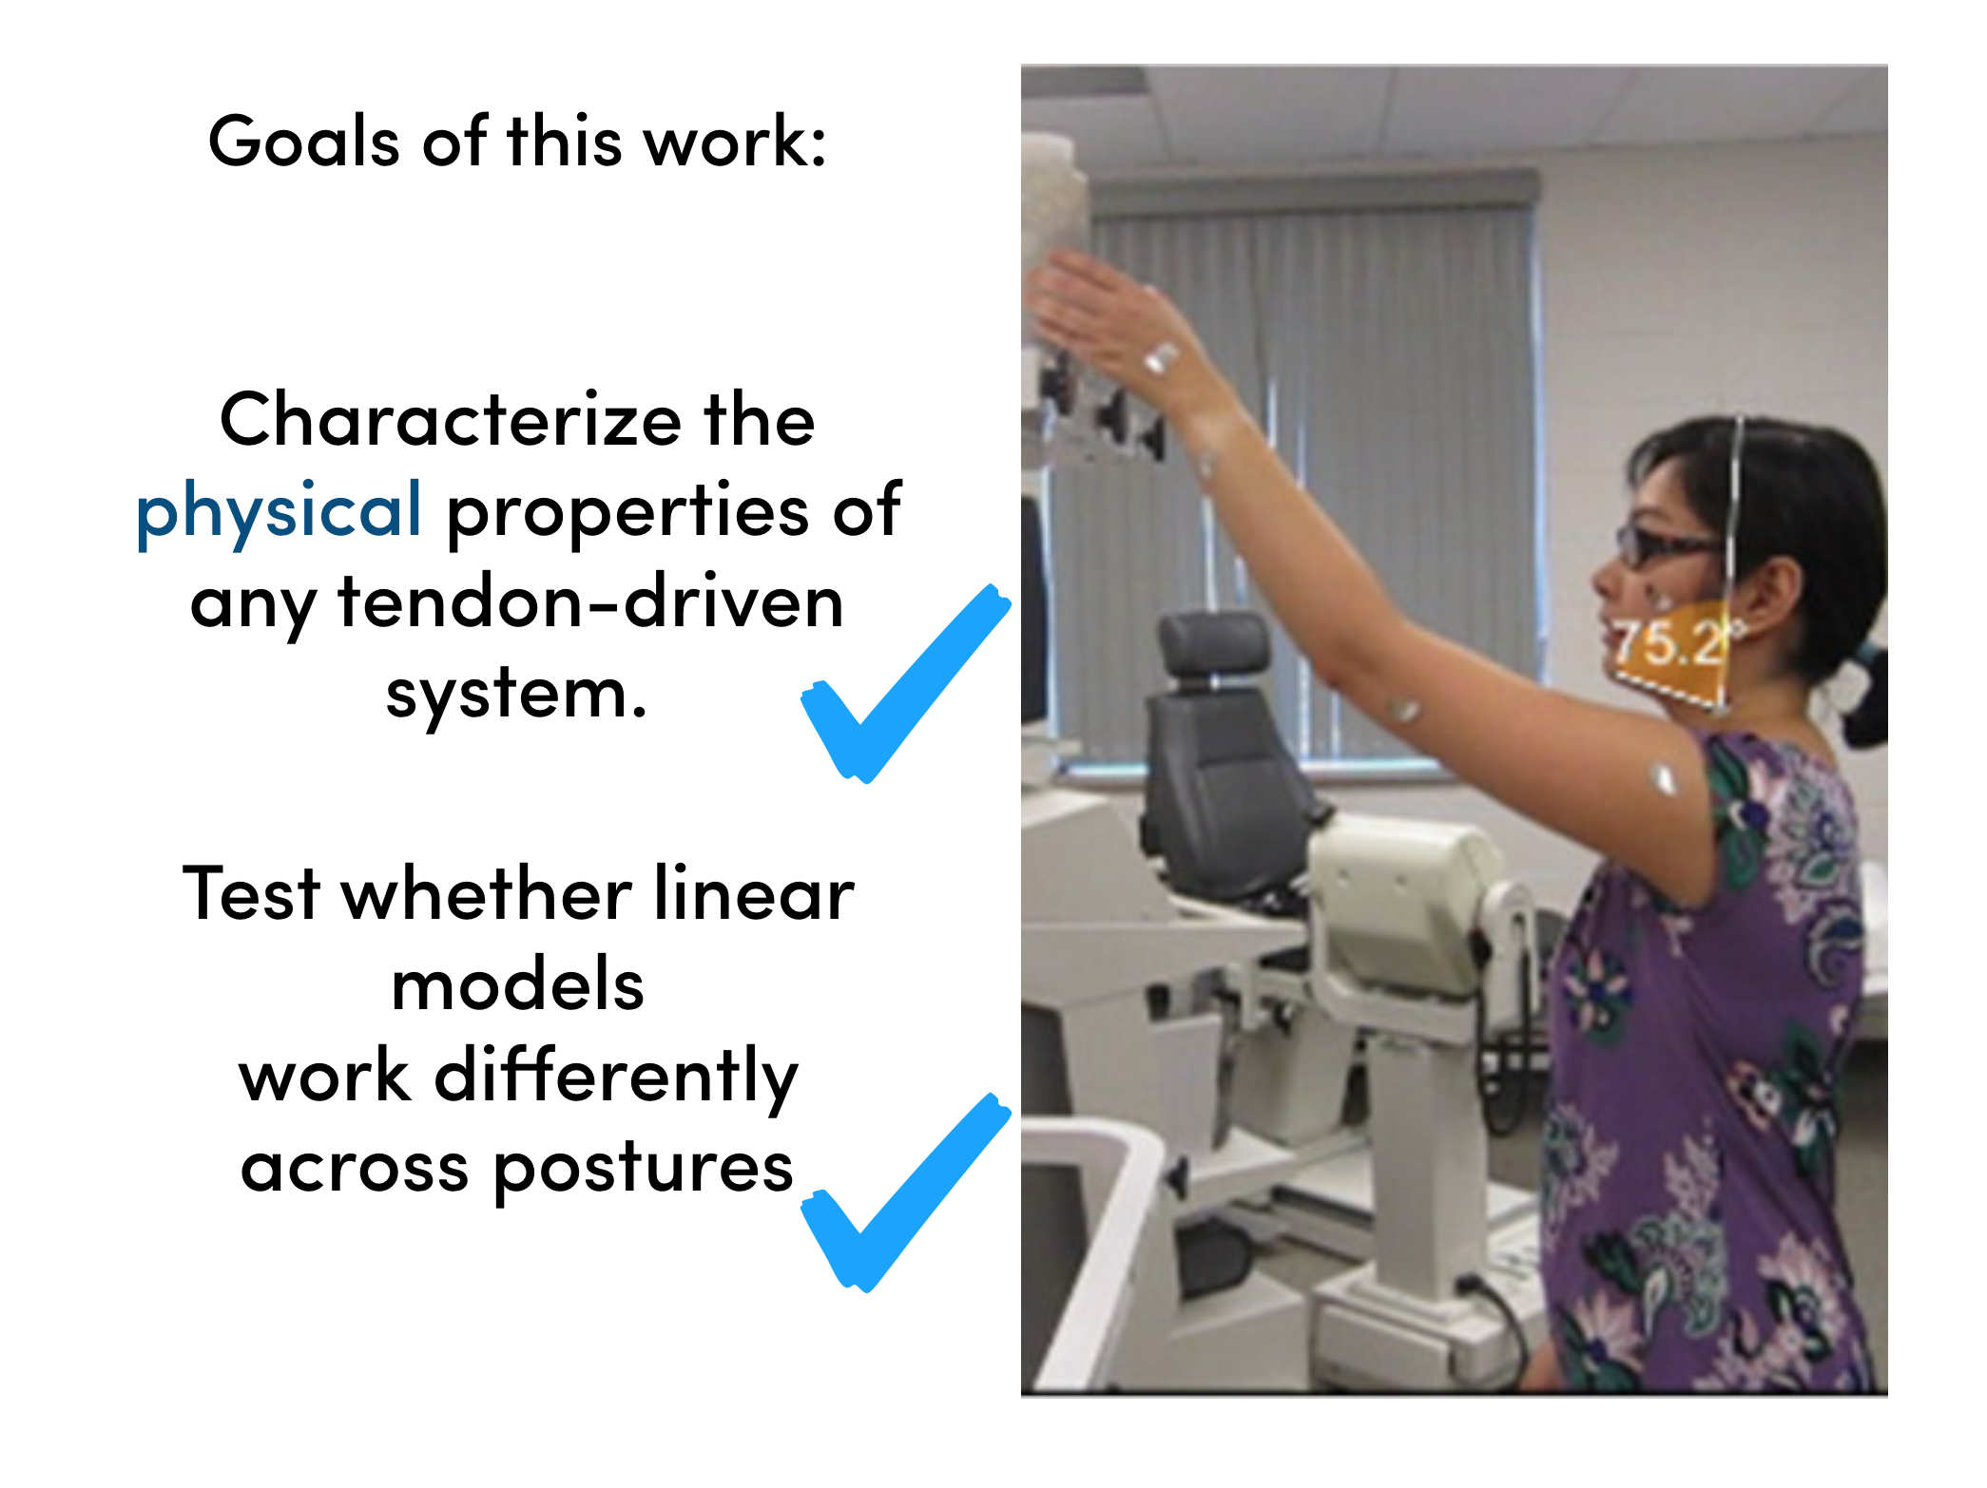

Slide 4
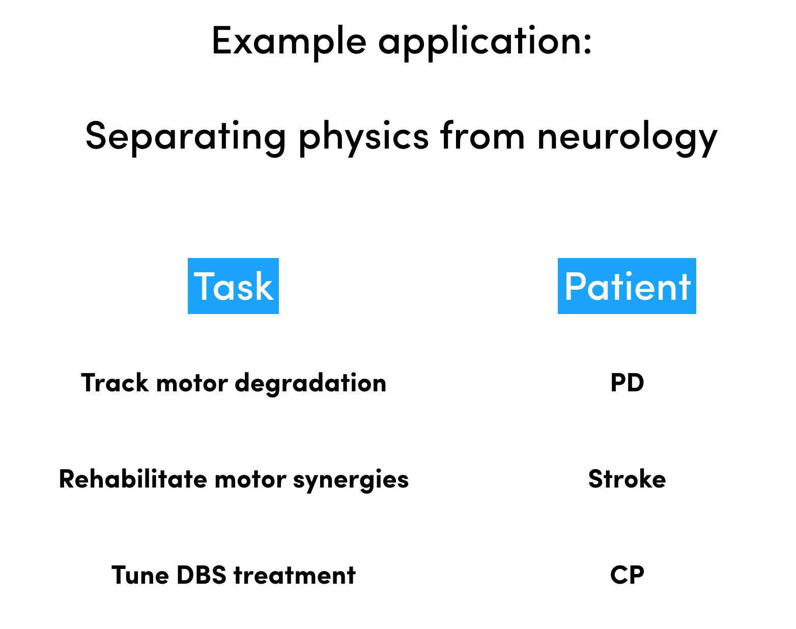

Slide 5
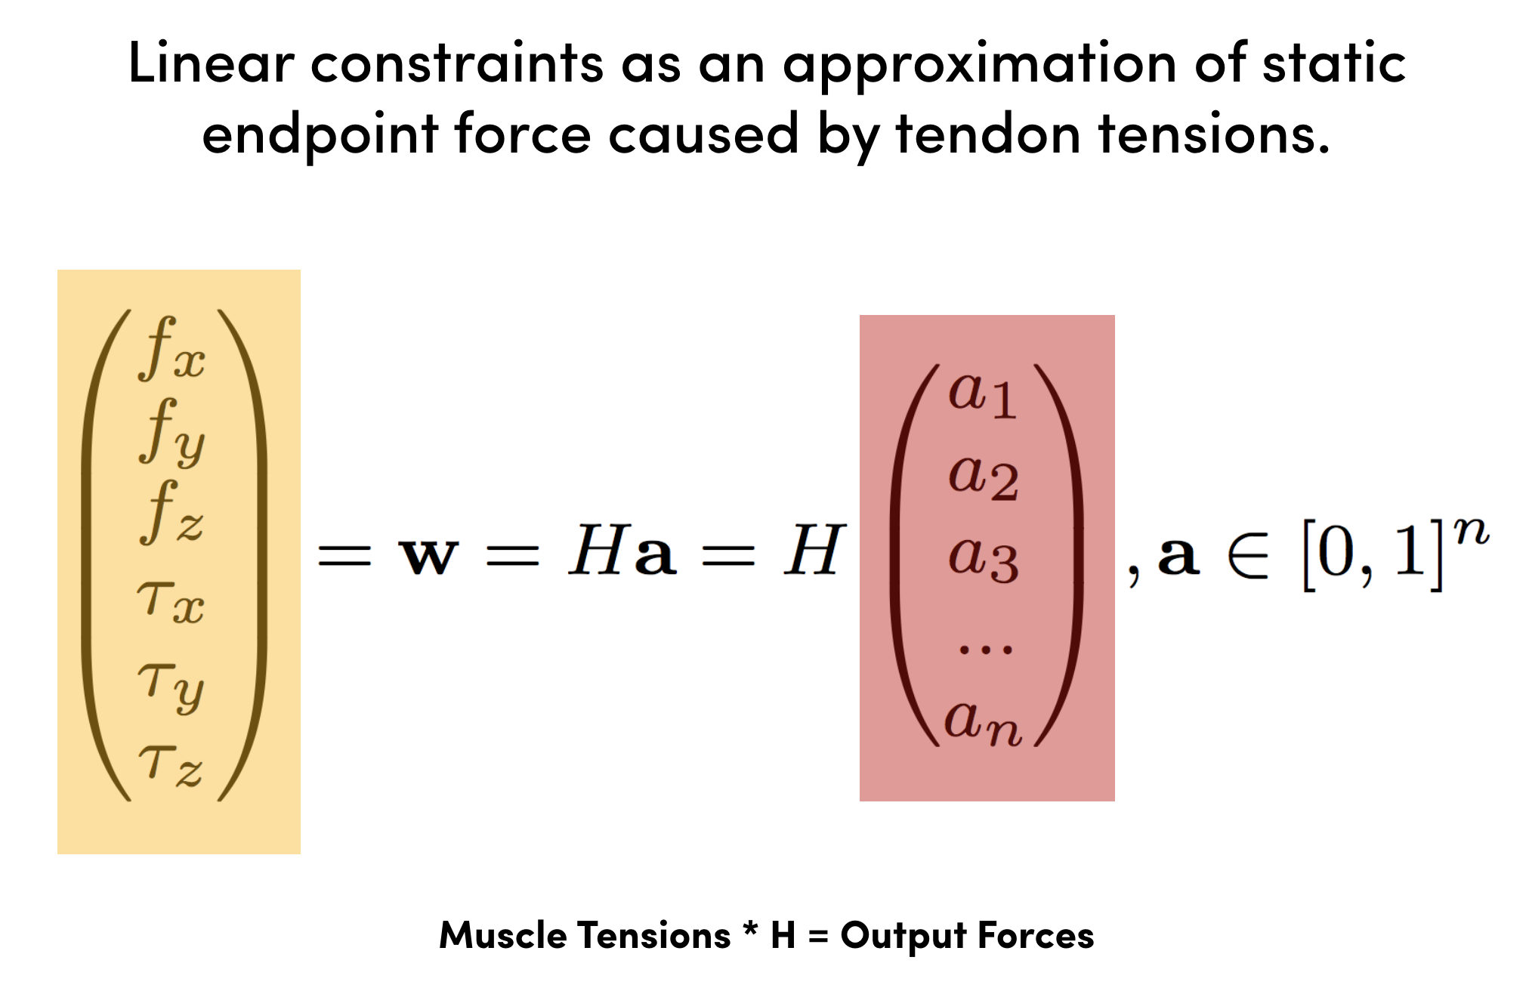
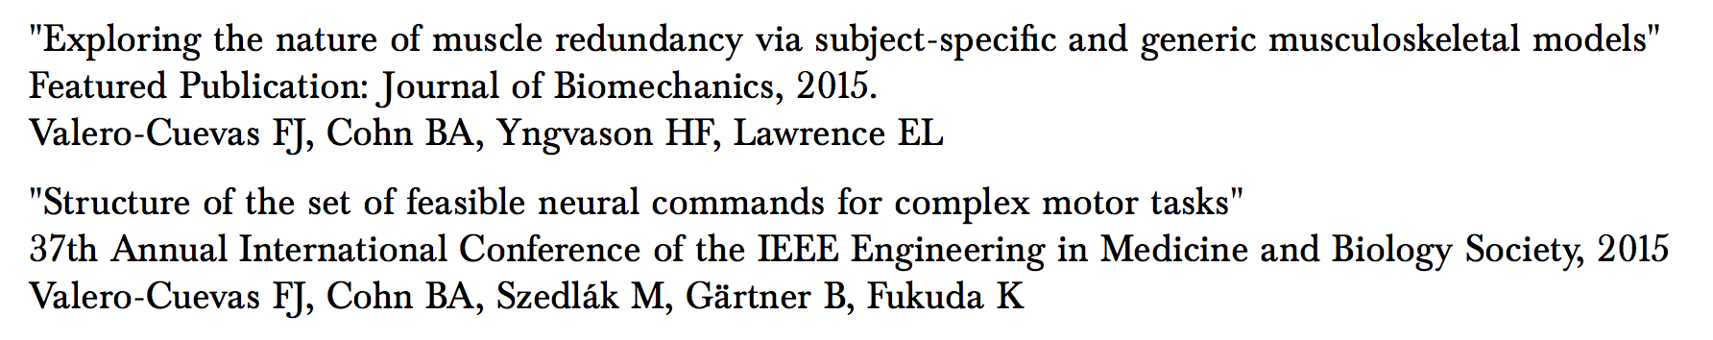

Slide 6
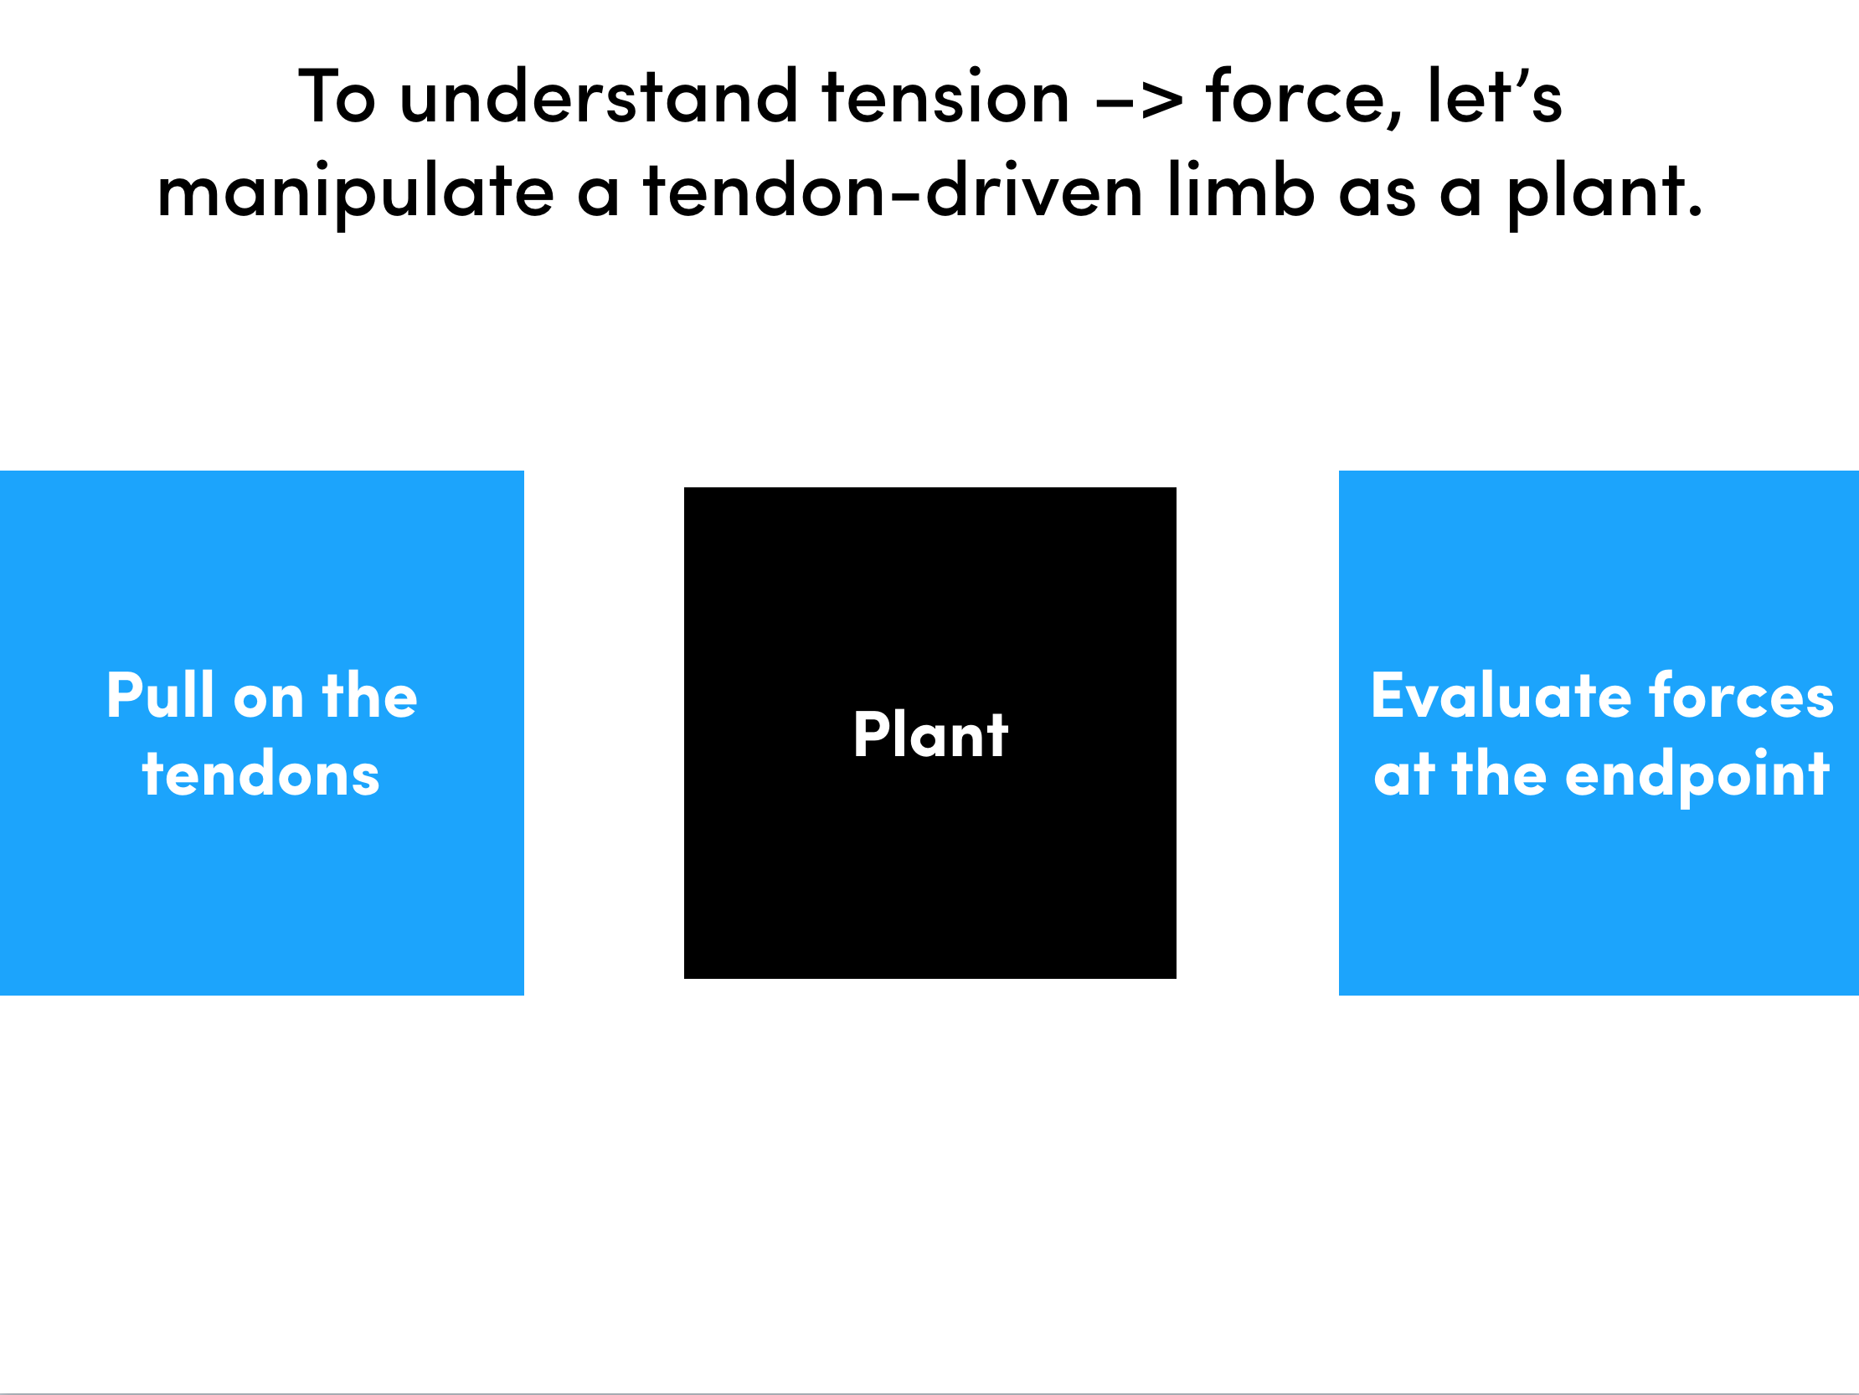
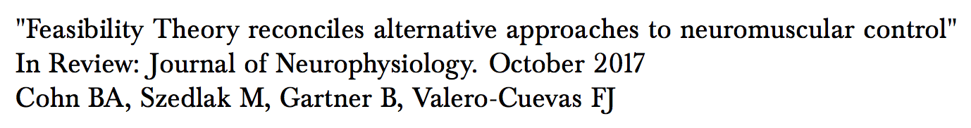

Slide 7
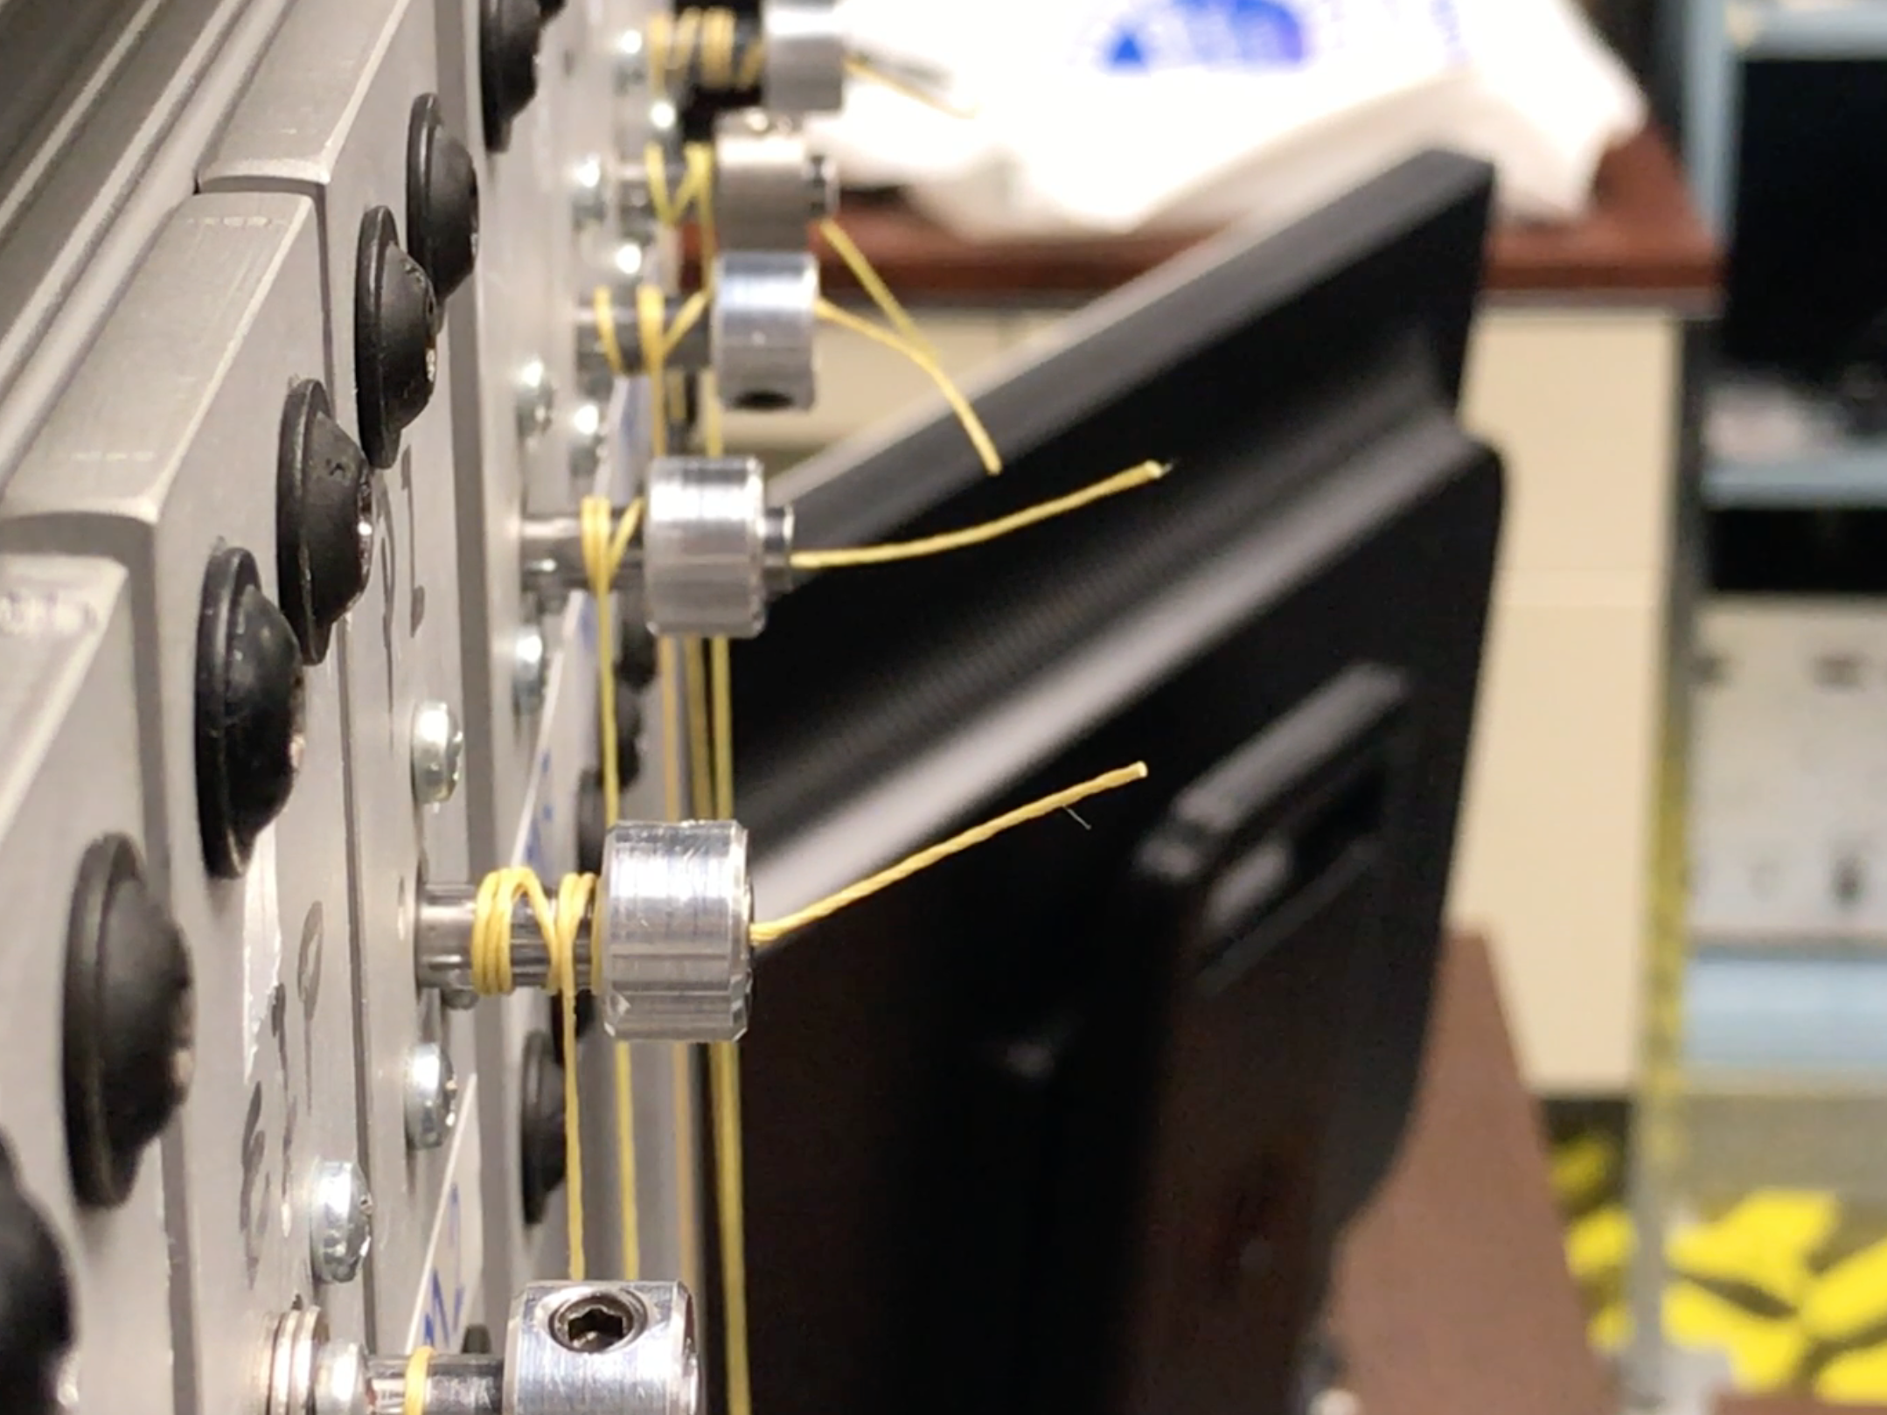

Slide 8
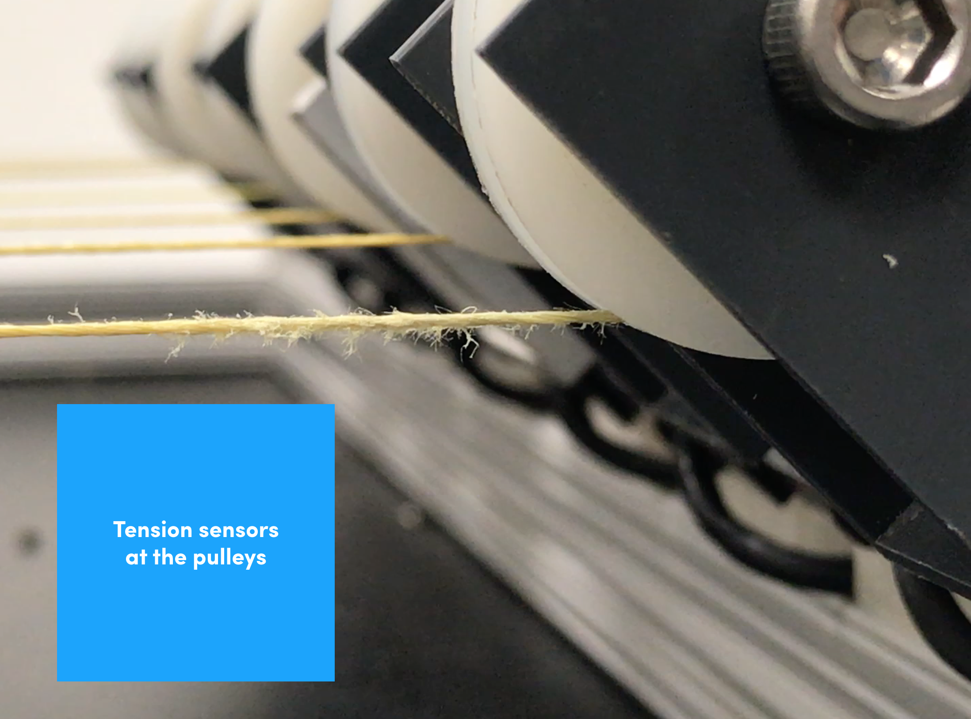

Slide 9
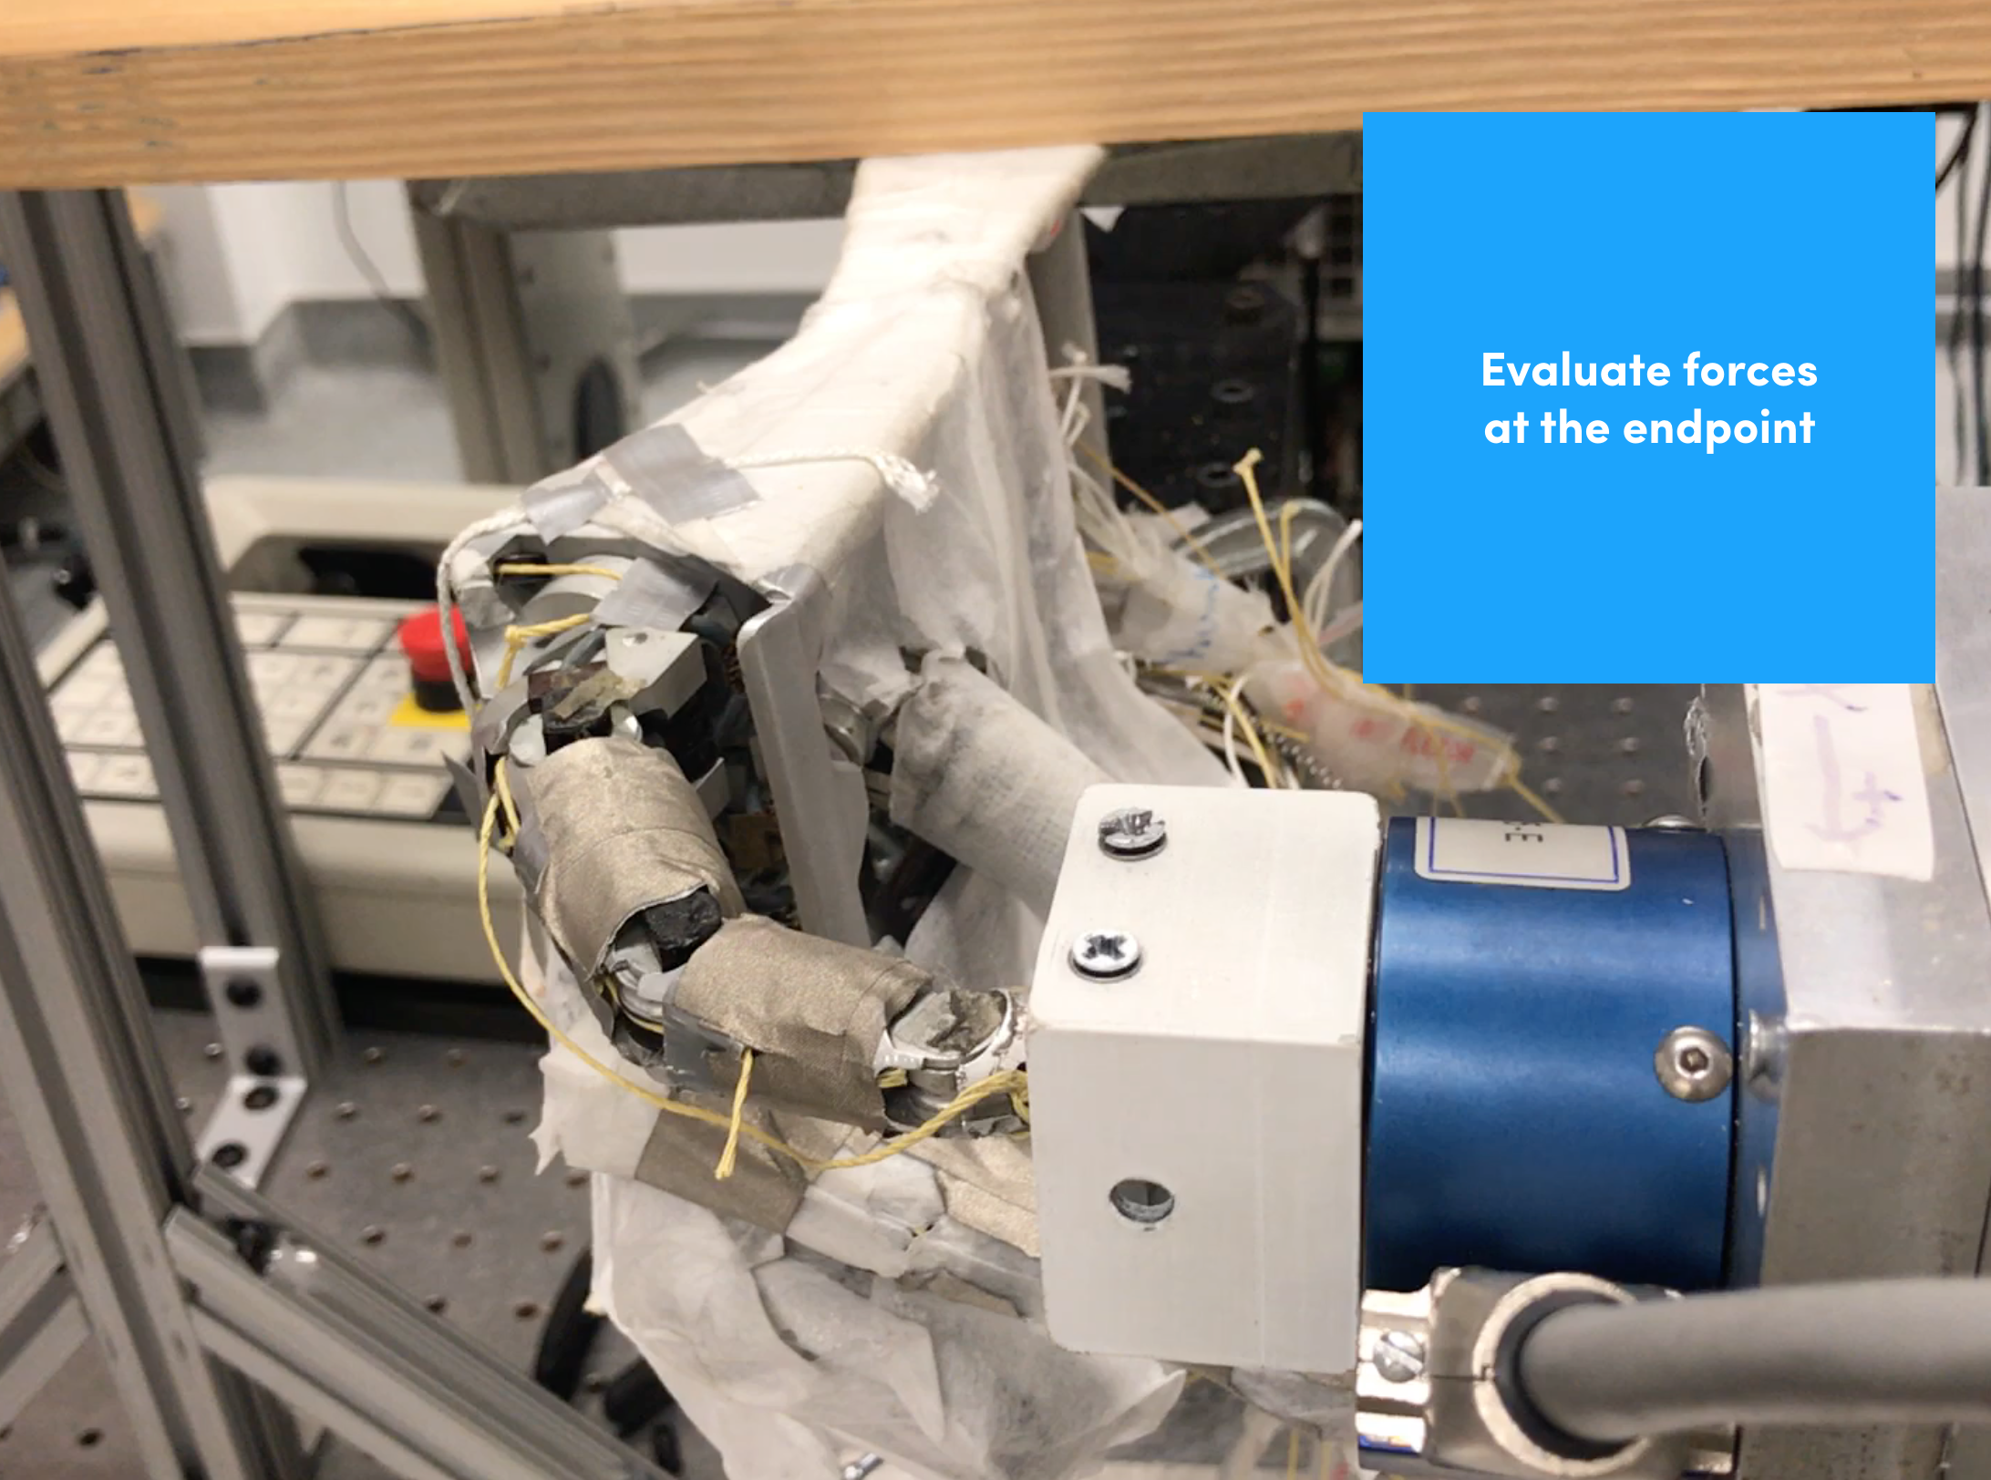

Slide 11
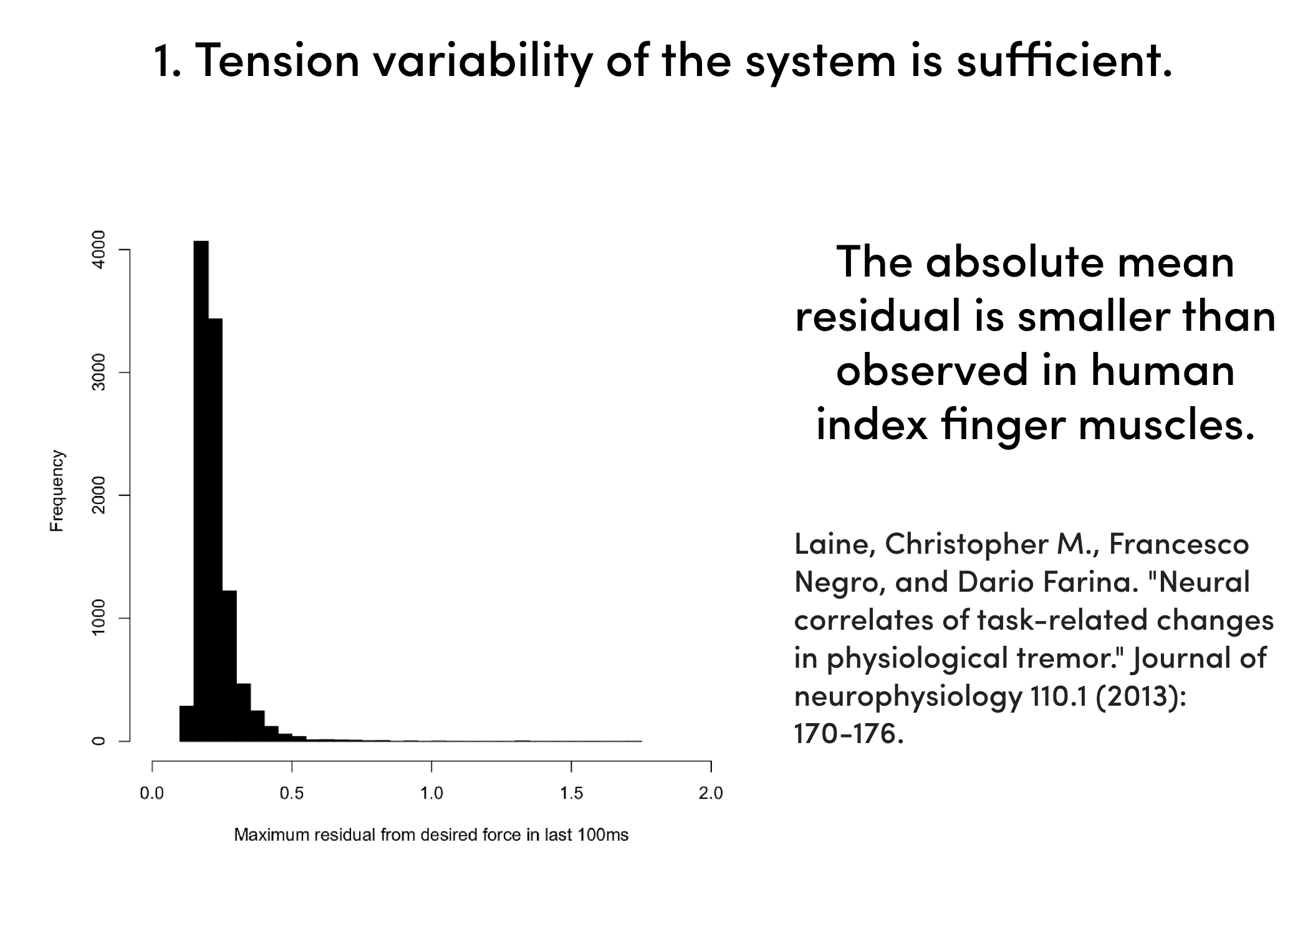

Slide 12
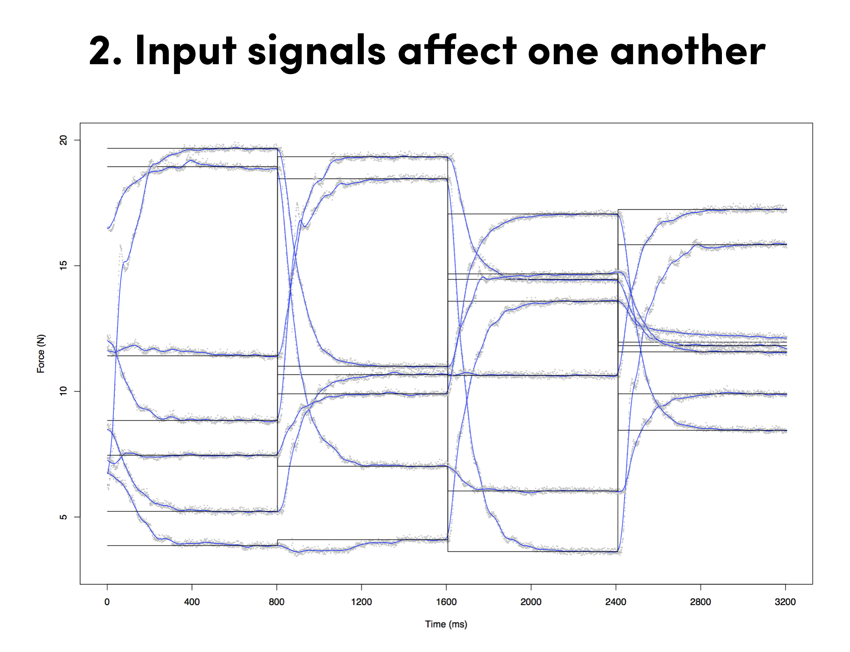

Slide 14
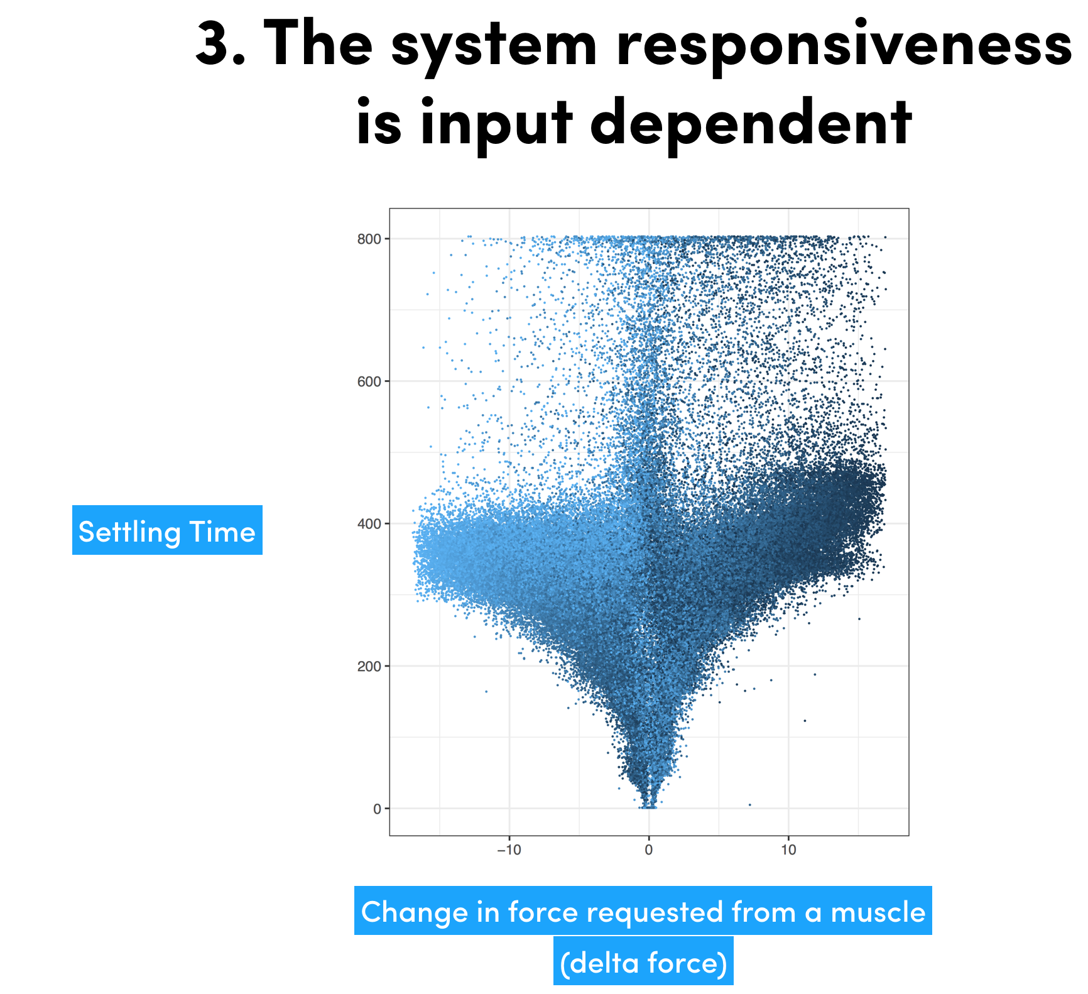

Slide 15
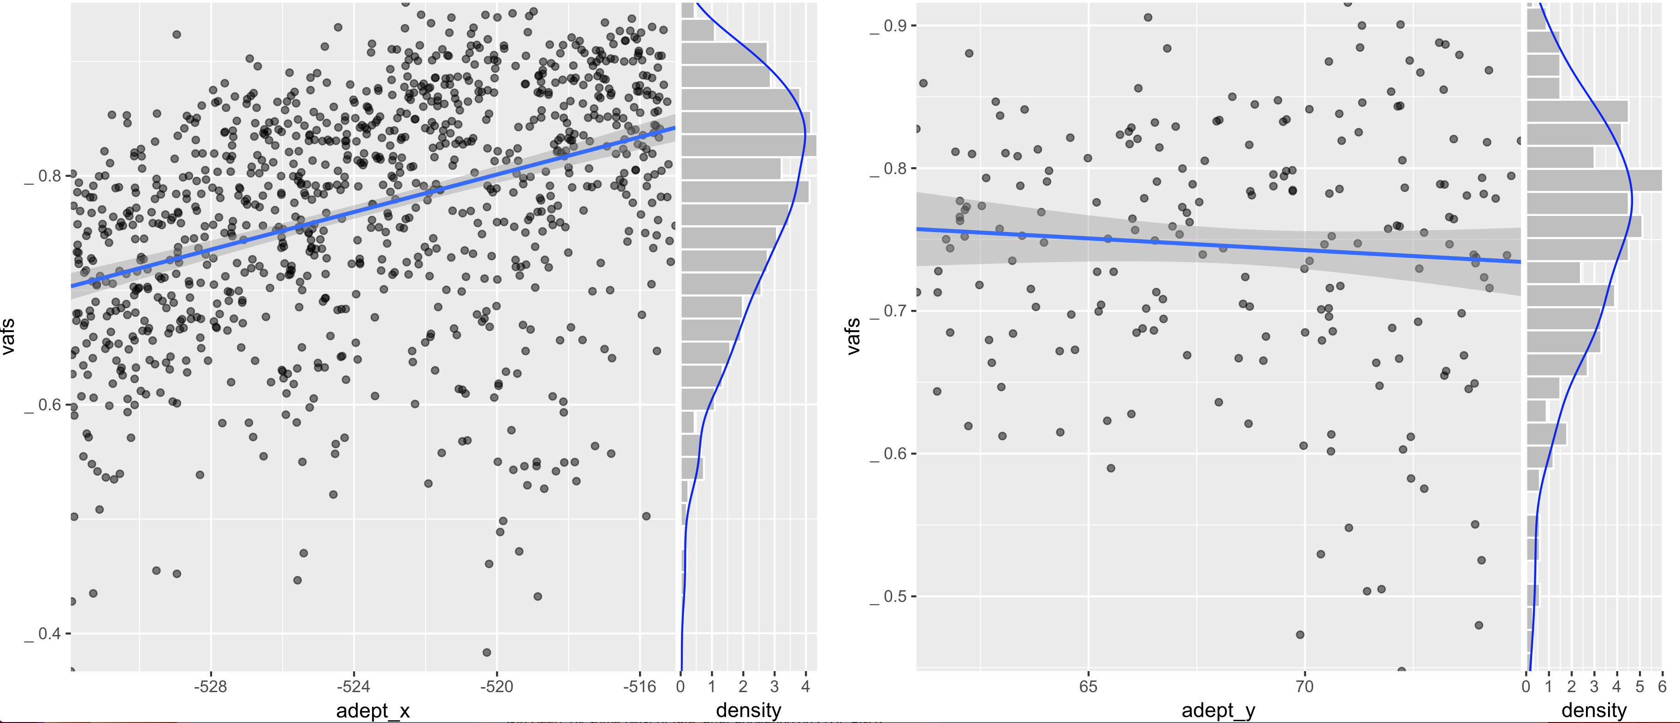
4. Posture dependency of linear fit is not always present.
N = 1000 postures, p<0.00001
N = 206 postures, ns

Slide 16
Other observations and their implications:
1) A 400ms settling time
2) 75% VAF in ~20 forces
10s to assemble a 75% accurate A matrix

Slide 17
a) New modeling paradigms that incorporate plant dynamics
b) Cadaver Studies
Evolution of motor learnability in non-human primates & human hand
c) Soft robotic optimization studies
d) Let me know if you want to test a specimen!

Slide 18
Takeaway Points
Be careful when modeling musculoskeletal systems with revolute assumptions
Linear model performance is not always posture dependent.
Muscle forces affect one another through a physical plant, irrespective of descending drive topology.
brian.cohn@usc.edu
Acknowledgements
Brain Body Dynamics Laboratory - USC Viterbi Fellowship - NSF Graduate Fellowship
Chris Laine, Brandon Miura, Taylor Stroobosscher, Mayumi Ishikawa,

